Slide 1
Sample Output Screenshots
(and notes)

Slide 2
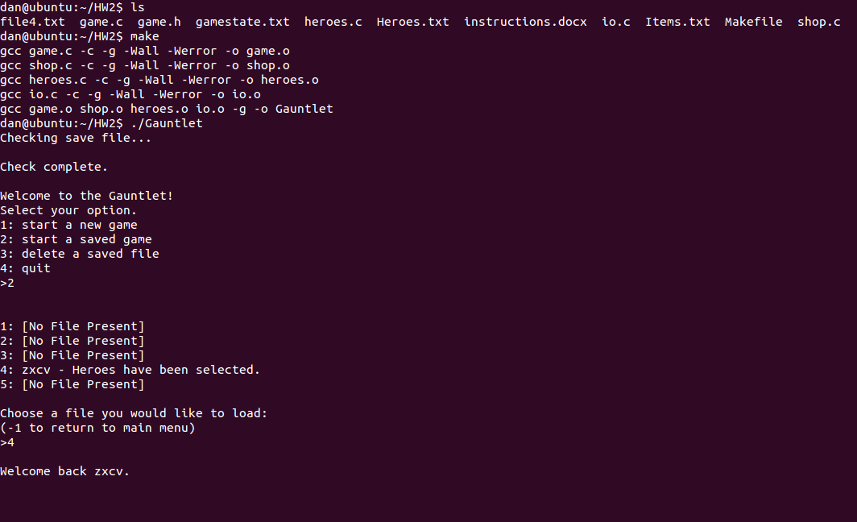
The layout of this powerpoint is the same as before.
Many things you see are as a result of the code prewritten for you. Find and pay attention to the pieces that relate to what you are writing.
This demonstrates how to use the makefile. The file called ‘Makefile’ has all the compilation rules, all of which can be run by running the ‘make’ command. Note that the executable name is ‘Gauntlet’.
In terms of the game itself, nothing should be new here. For demonstration purposes, a save file has been prepped to save time, as much of this is from HW1.

Slide 3
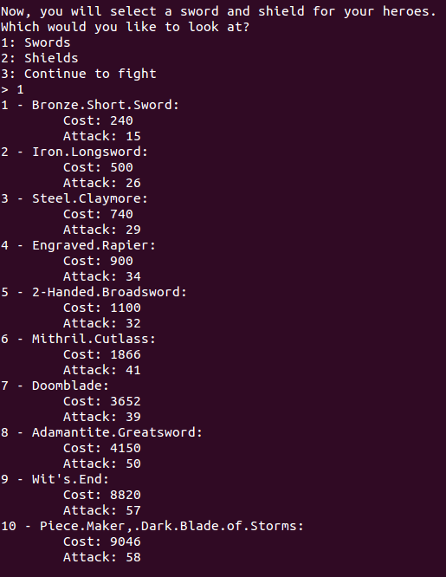
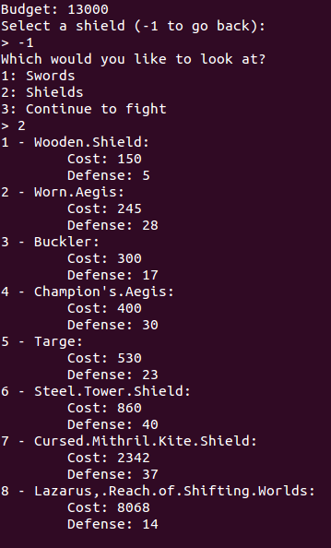
Note the output. The menu is generated from printing out the linked list. Also note the number system for the menu.
At this point in the program, the lists are sorted. You are encouraged to test the output of your lists before you sort to make sure the loading and printing works. The program should work as expected throughout regardless of whether or not the lists have been sorted.

Slide 4
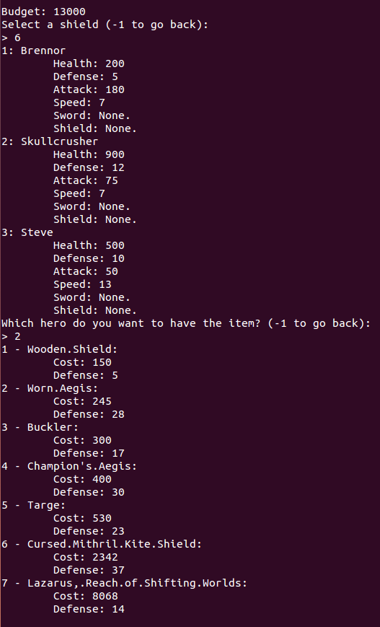
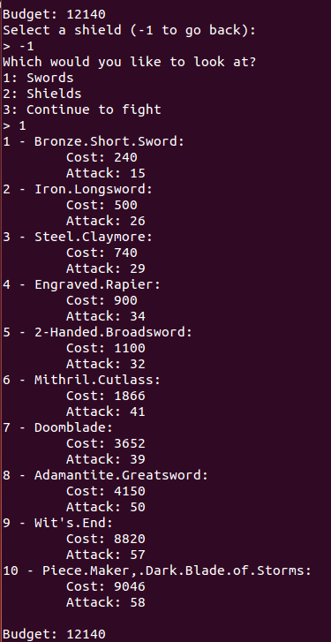
Note what happens when the item is purchased. The item is removed from the list, and the output menu is updated to reflect the item no longer available, and the number options changed to stay aligned. Also note that the correct amount was subtracted from the budget to confirm that the item removal function actually worked for the chosen item.

Slide 5
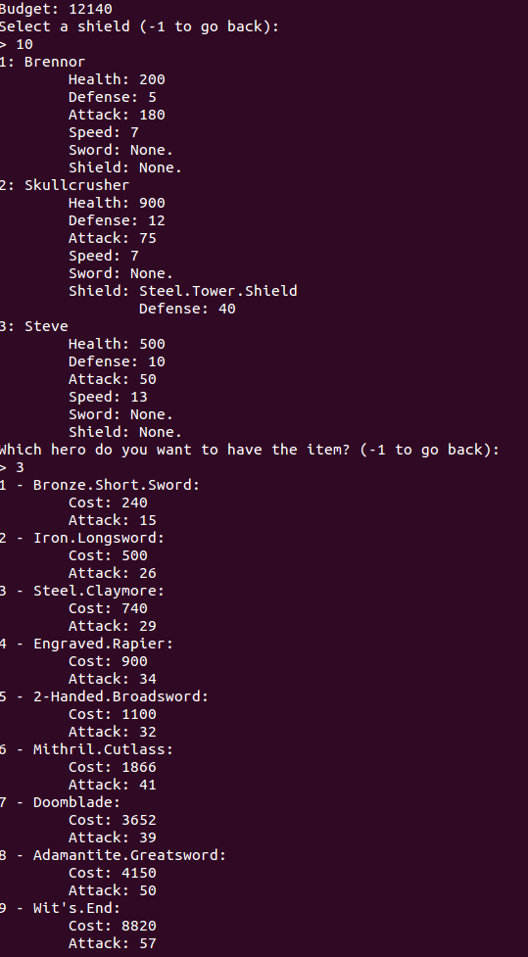
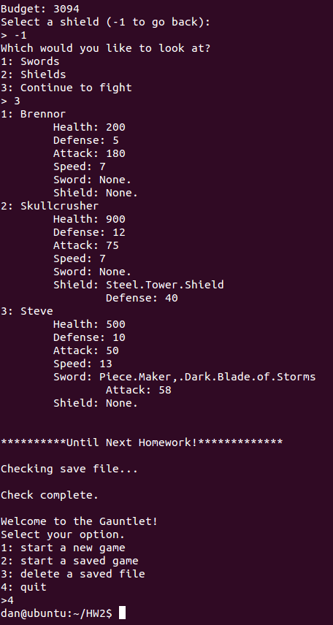
Observe similar behavior with the swords as with the shields. Note that the program works regardless of the chosen item’s position, and the program exits without errors to confirm that destroying the lists were successful.

